Slide 1
Implementation of a 'toy'-CBIR
Non-Textual Data Extraction Assignment - Implementation of a 'Toy' CBIR
Group Members: Della Valle Francesco, Gonzalez-Almansa Laredo Carlos, Saviano Gaetano, Jain Arth Amit
Course: Information Retrieval, Extraction and Integration
Date: February 2024

Slide 2
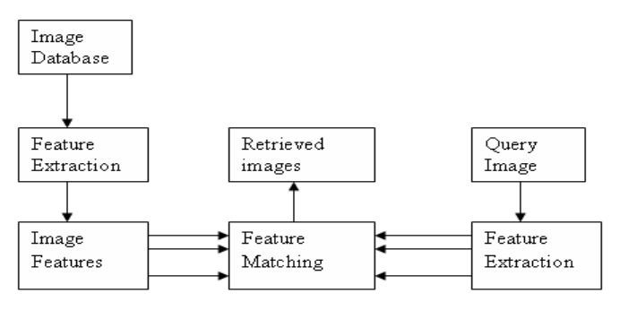
Introduction
Create of a Content-Based Image Retrieval (CBIR) system enabling users to search for images based on their visual features rather than relying solely on textual annotations.
Primary Goal :
Developing a CBIR system capable of retrieving images based on visual content.
Figure 1.1: Architecture of CBIR system

Slide 3
Applications of CBIR
There are various applications of CBIR used to solve real-world problems. Some of them are listed below.
Art Collections Management
CBIR systems can assist art curators and historians in managing large art collections by facilitating the search for artworks based on visual similarities, styles, or attributes.
Medical Imaging Analysis
In the field of medical imaging, CBIR systems aid healthcare professionals in diagnosing diseases, planning treatments, and research.
Satellite Imagery Analysis
CBIR systems play a crucial role in satellite imagery analysis for various applications, including urban planning, environmental monitoring, and disaster response.

Slide 4
Approach and Implementation
CBIR System Development
Implementation of 'smart' Histograms and distance
Implementation of a second descriptor and distance
Descriptors Combination
Implementation Additional CBIR processes
The GitHub repository link: https://github.com/GaetanoSaviano/Non-TextualDataExtractor

Slide 5


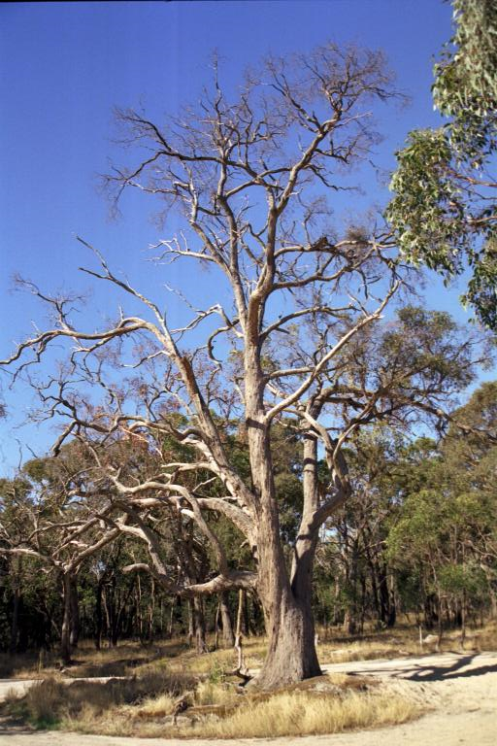
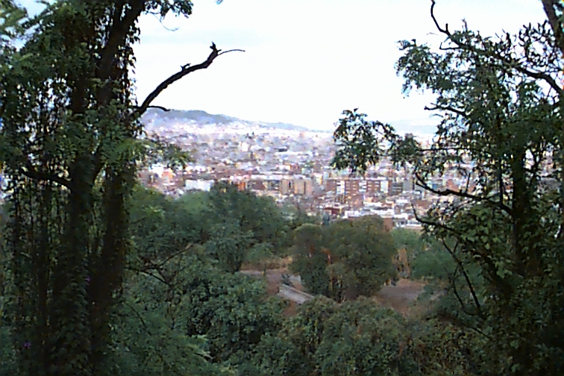

Dataset
Figure 1.2: Italy dataset

Slide 6

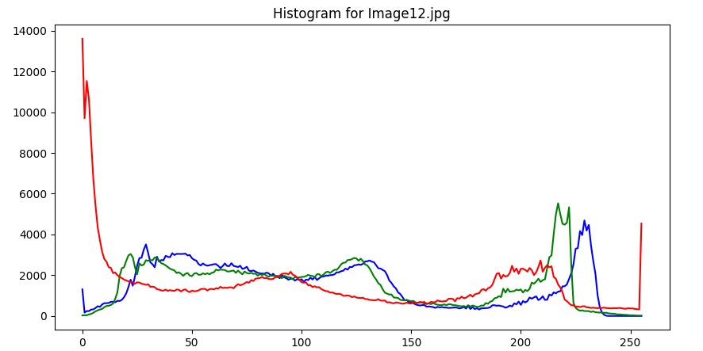
Color Space and Color Histograms
Figure 1.3: image and corresponding histogram
Color-based image retrieval and the use of color histograms.
Color based image retrieval is the most basic and most important method for CBIR. Color features are the most intuitive and most obvious image features
The color space needs to be divided into several small ranges in order to calculate the color histogram. Each interval is regarded as a bin. Thus, the color is quantized.

Slide 7
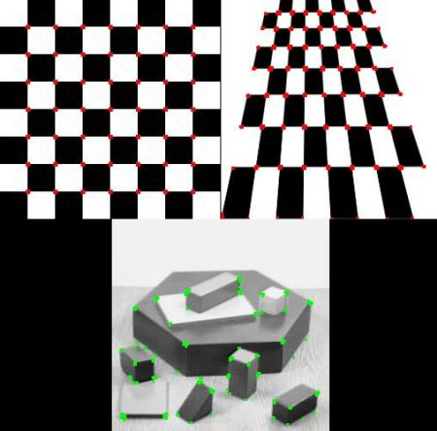
Descriptor Generation and Distance Management
Systems extract vectors of features from images and use speciﬁc metrics for comparing them. Once we have the descriptor, we had to choose a distance to compare instances and get the most similar ones in the color dimension.
As a secondary descriptor we used the Harris Corner Dectector which is a widely utilized computer vision technique designed to identify key interest points within an image by leveraging local intensity variations, used to detect discriminating features in an image. The features should be reasonably invariant to translation, rotation, and illumination.
Figure 1.4: Harris Corner Detection

Slide 8
Implementation of additional CBIR processes
In order to make the system scalable we don’t store images themselves but the descriptors of every image (identified by its unique name) into a .npy file which can be easily loaded when starting the program.
New images could be added, for that it just need to calculate its descriptors and store them in the file.
This search function performs image similarity search using a descriptor database. This function effectively implements an image similarity search process using color and Harris descriptors, aligned with the concept of Content-Based Image Retrieval (CBIR).

Slide 9
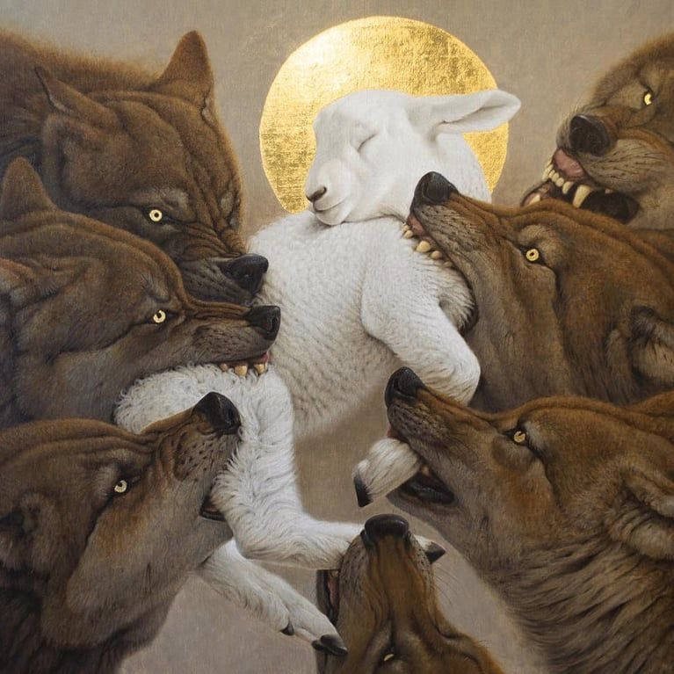
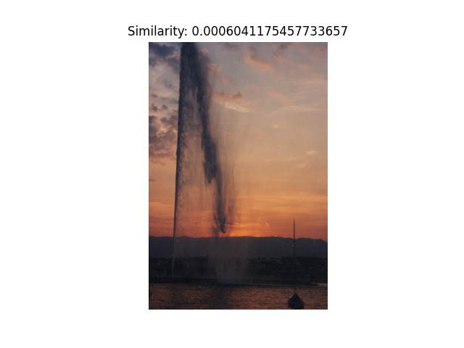
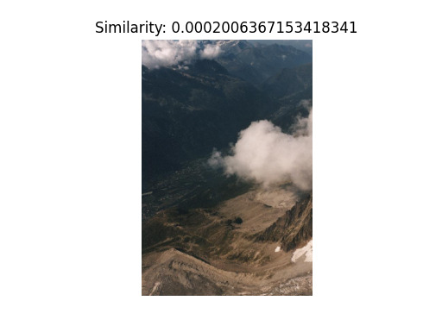
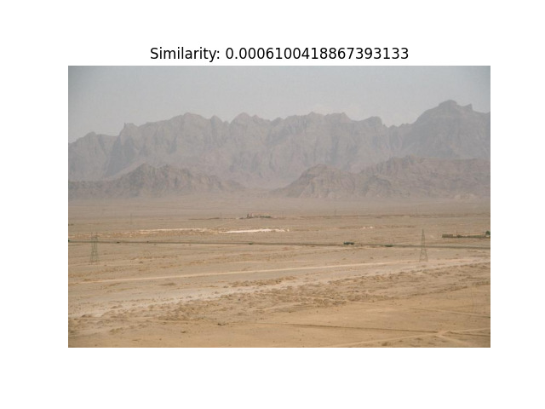
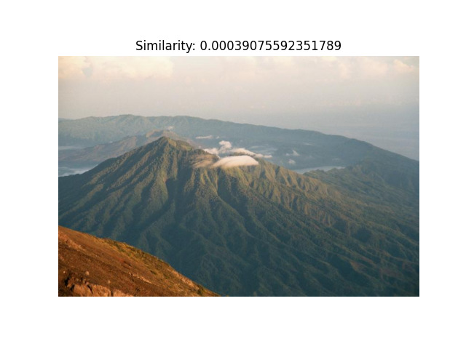
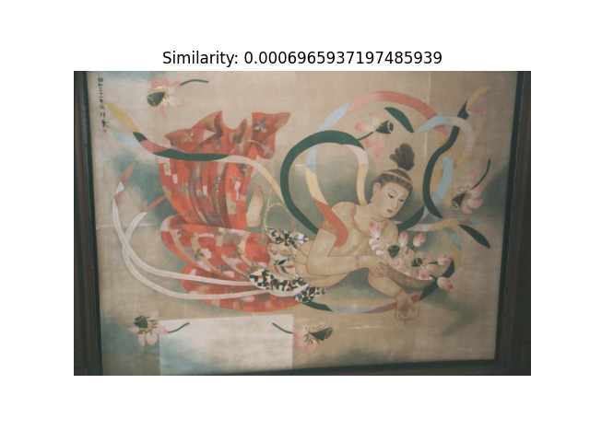
Results
Figure 1.5: Query image
Figure 1.6: Results produced by the CBIR system

Slide 10
Future Direction
Integration of Deep Learning Techniques
Incorporating deep learning techniques, such as convolutional neural networks (CNNs), could significantly enhance the performance and robustness of the CBIR system.
Multimodal Fusion:
Exploring multimodal fusion approaches to integrate information from multiple modalities, such as text, audio, and video, could further enrich the CBIR system's capabilities.

Slide 11
Thank You

